Slide 1
Module 3 Relational Data Model and CREATE TABLE Statement
Lesson 2: Integrity Rules
Notes:
Welcome to Lesson 2 of Module 3 on the relational data model and the CREATE TABLE statement
This lesson continues our study of the relational data model and the SQL CREATE TABLE statement
This lesson covers two major rules for storing rows in relational databases.
Opening question:
What is the consequence of two taxpayers or customers with the same government identifier or customer identifier?
What is the consequence of a shipment connected to the wrong order?
Relational databases are the dominant commercial standard
- Simplicity and familiarity with table manipulation
- Strong mathematical framework
- Lots of research and development

Slide 2
Lesson Objectives
Identify 1-M relationships and associated primary keys (PKs) and foreign keys (FKs)
Find errors in rows with either orphan FKs or missing FKs
Identify situations for FK requirements
FK is necessary
FK can have the null value
Notes:
First bullet change with full names (primary key and foreign key) for acronyms

Slide 3
Definitions
Null value
Absence of a value (missing value)
Primary key (PK)
Column or combination of columns with unique values in each row
Foreign key (FK)
Column or combination of columns
Actual value unknown or not applicable for a row
No extraneous columns (minimal)
Related to a primary key in a related table
Same data type and often same name as related PK
Notes:
Two key definitions. Textbook has other definitions, but PK and FK are the most important.
Minimal
Cannot remove any columns and still retain uniqueness of values
Single column PKs are always minimal.
Null value
Missing value or absence of a value
Actual value is unknown or does not apply to a specific row

Slide 4
Integrity Rules
Entity Integrity
Primary key for each table
Referential Integrity
Two kinds of values for a foreign key in a row
No missing (null) values for primary keys
Ensures traceable entities
Match a primary key value of a related table (usual)
Null value (unusual)
Ensures valid references among tables
Notes:
Informal definitions
Examples:
- Student rows are uniquely identified by StdNo
- Offering rows are uniquely identified by OfferNo
- Enrollment rows are uniquely identified by the combination of StdNo and OfferNo
- Enrollment.StdNo refers to a valid StdNo value in the Student table
- Enrollment.OfferNo refers to a valid OfferNo in the Offering table

Slide 5
Integrity Rule Violations
Notes:
Missing value for PK of Student table (4th row)
Orphan row in Enrollment: 5th row with OfferNo 6789
Missing value of part of a PK for Enrollment (6th row)

Slide 6
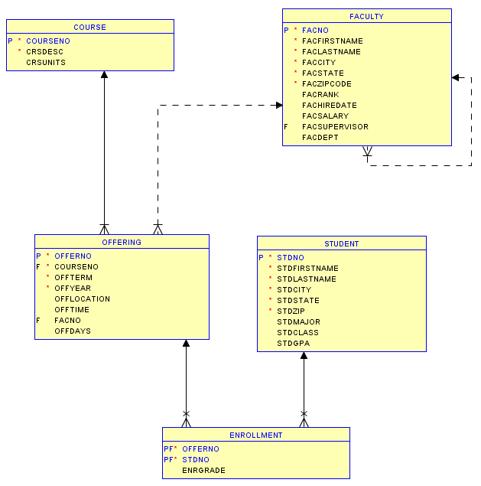
Oracle Relational Diagram
Notes:
Oracle Relational Diagram
Created in Oracle SQL Developer
Select New Design in Data Modeler -> Browser
Drag tables into design window
View Details: show only columns in this diagram
Can also show other details such as data types
Notation
Solid line: mandatory relationship (NOT NULL constraint for FK)
Dashed line: optional relationship (NULL values allowed)
Cross: FK is part of PK
Red circle: required column (does not allow null values)

Slide 7
Summary
Identify primary keys and foreign keys
Visualize relationships
Understanding existing databases is crucial to query formulation
Notes:
Valid reference problems
Orders without a customer or incorrect customer
Order without a shipment
Missing reference values represent valid rows (internet order without an employee) or data entered later (offering with instructor reference later).
Understand a database is a prerequisite to query formulation
- How are rows identified? PKs and CKs
- What data can be compared? Data type knowledge
- How can tables be combined? Foreign keys and relationship details (1-M relationships)
- Visualization: show the direct and indirect connections among tables

